Slide 1
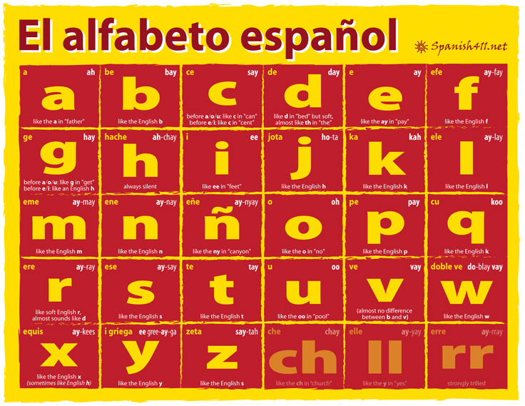
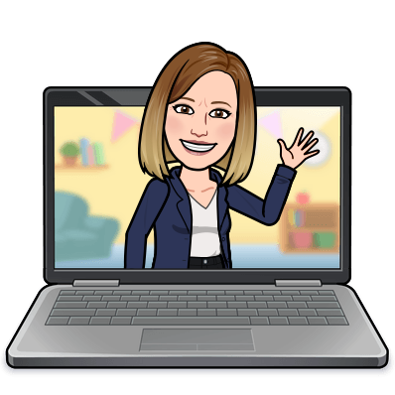
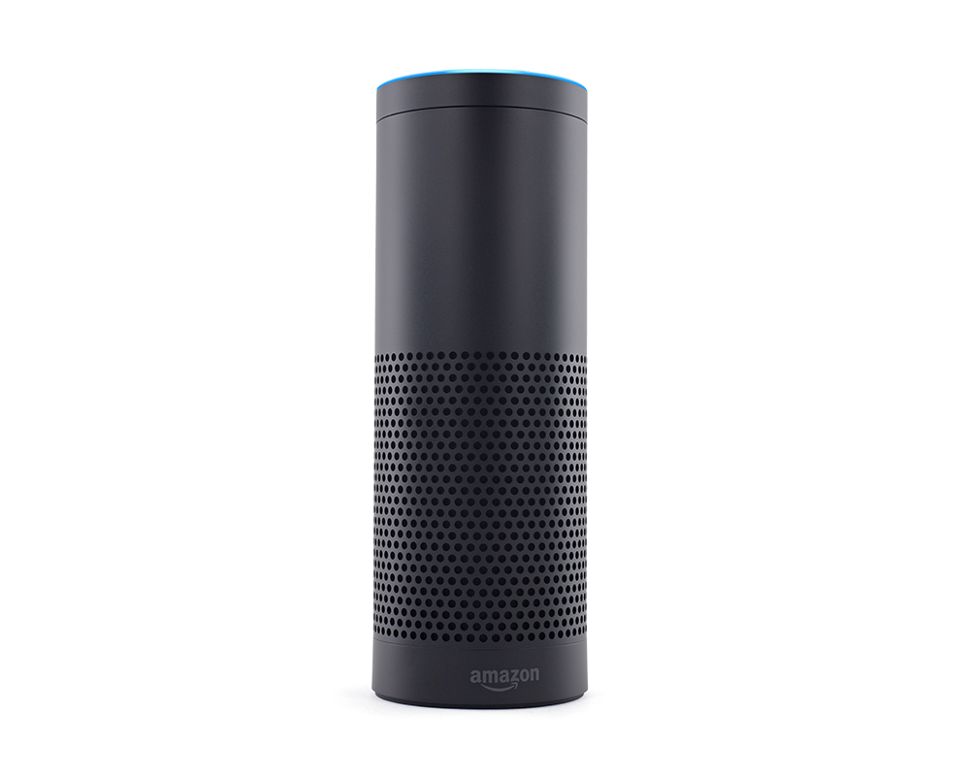
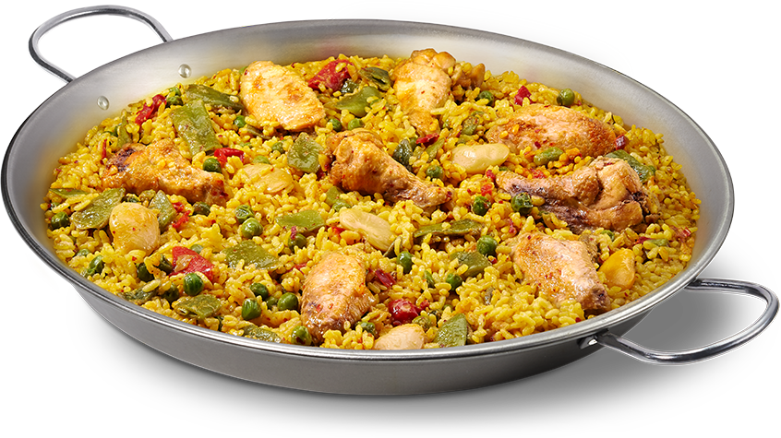
Welcome to our Virtual Spanish Classroom!
¡Buenos días clase!
Navigate your way around our virtual classroom.
You will find links to Blooket, Quizlet, Linguascope and much more!
There are also some challenges and links to Spanish radio and YouTube, as well as a Flamenco lesson!
Enjoy!
Memrise
BBC Bitesize
Linguascope
Duolingo
Languages Online
BIN!
Google
Translate
Sings

