Slide 1
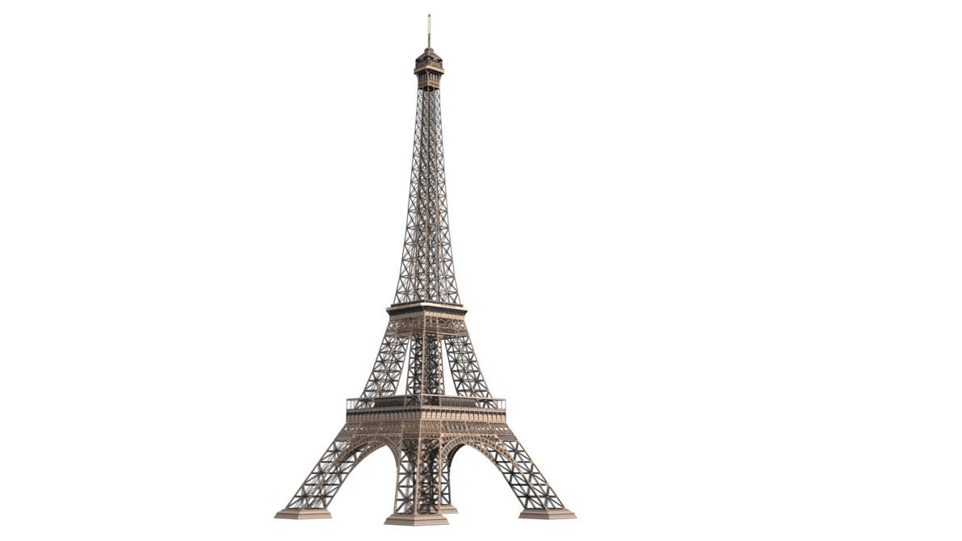
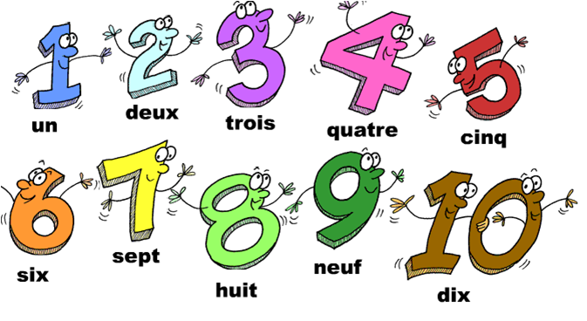
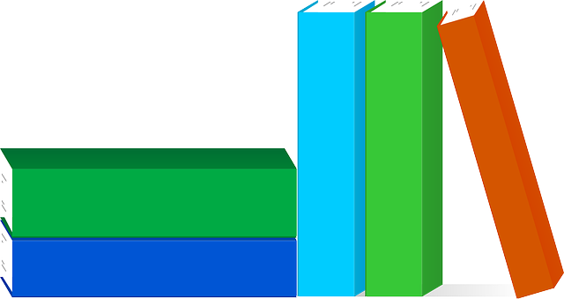
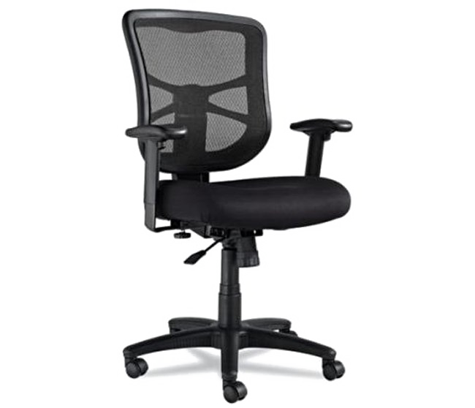
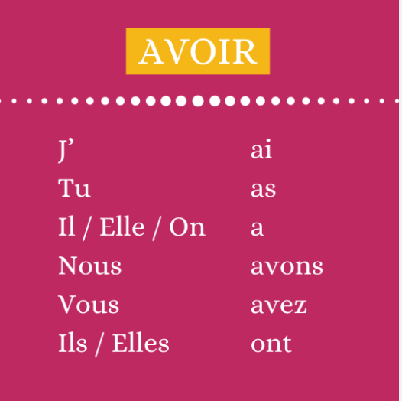
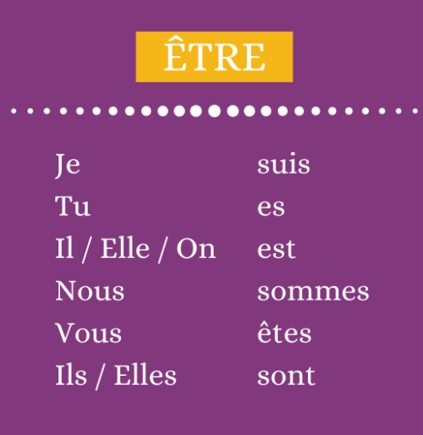
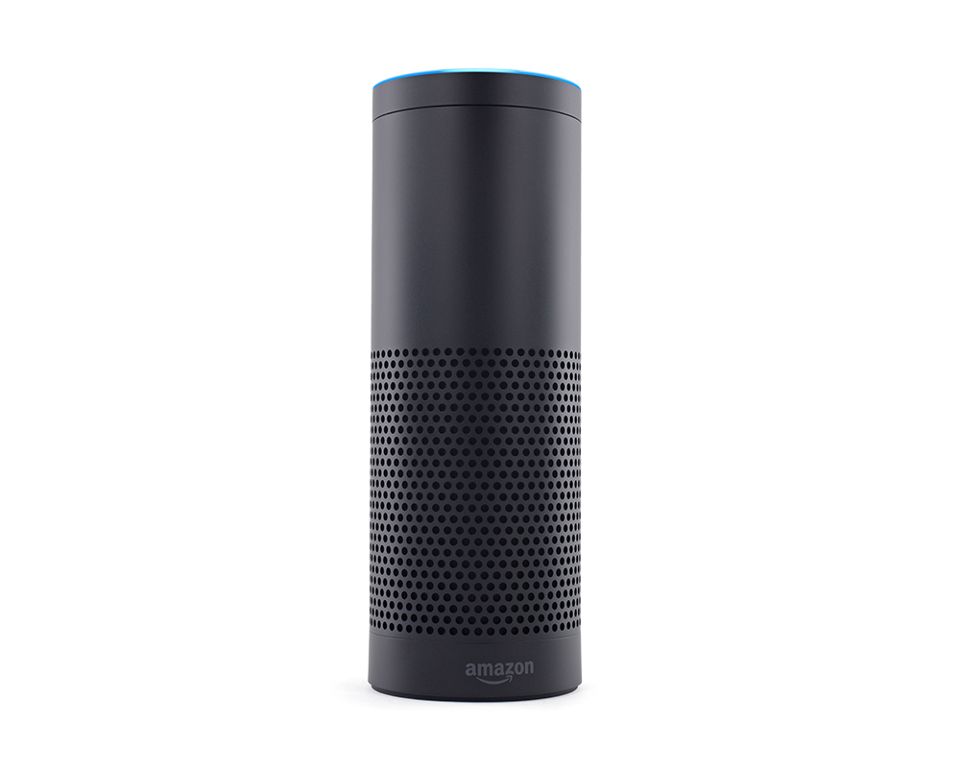
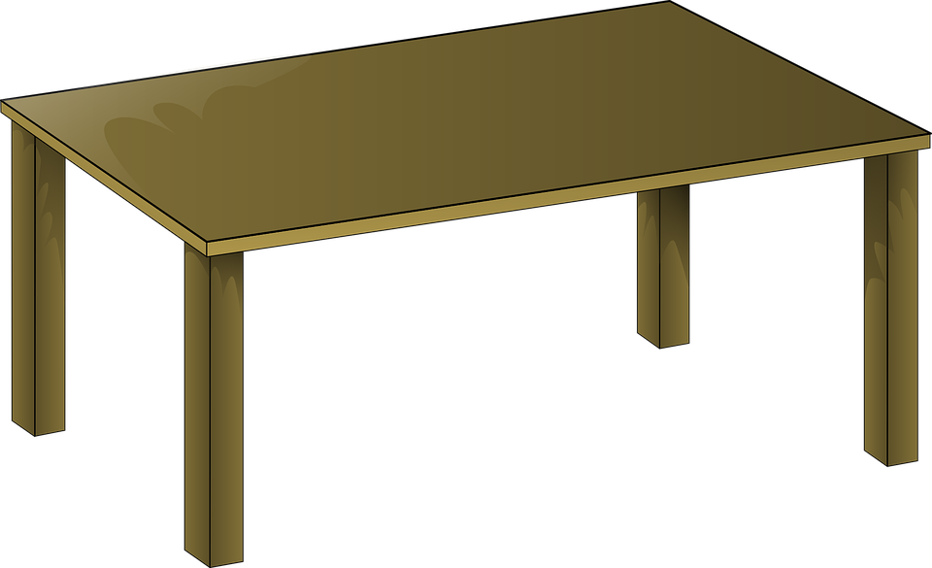
Welcome to our Virtual French Classroom!
Bonjour la classe!
Navigate your way around our virtual classroom.
You will find links cultural videos, grammar quizzes and websites.
There are also some challenges and links to French radio, Netflix movies and YouTube.
Enjoy!
80 Key
Phrases
Imperfect
Tense
Present Tense
BBC Bitesize
Future
Perfect Tense
Seneca
Memrise
Oak Academy lessons
BIN!
Google
Translate
Sings

